Slide 1

Assignment 4 Group 16
Daniel Workinn, I. Erdem Demir, Joshua Weil

Slide 2

Data Preparation

Slide 3
Raw Data Investigation
Optimizing ranking performance
→ No need to address imbalanced dataset
10% of the raw training data kept for AUC estimate
0.28%
99.72%

Slide 4
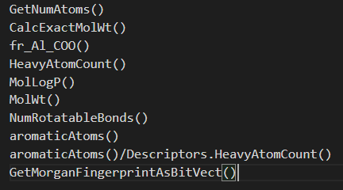
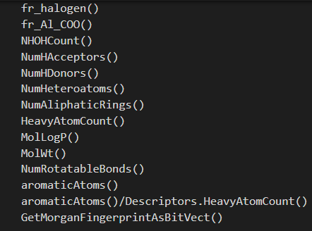
Creating Feature Sets
Two separate feature sets were created using RDKit
mostly motivated by Lipinski’s rule of five, a domain-specific ML blog and the RDKit documentation page

Slide 5
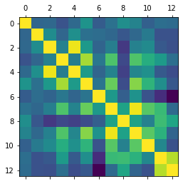
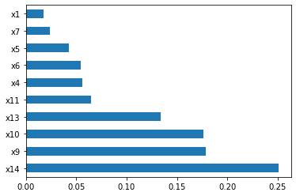
Investigation of Features
The correlation between features was examined using correlation matrices
Highly correlated features were dropped
The relevance of features was examined using scikit-learn’s ExtraTreesClassifier class feature importance
Least 2-3 important features were dropped

Slide 6

Model Testing

Slide 7
Preprocessing of Data before Model Testing
Different models require different preprocessing of the data
Use of scikit-learn’s preprocessing library, more specifically:
Standard Scaler
MinMax Scaler
KBinsDiscretizer
All three preprocessing methods applied to all models to examine the impact on the AUC score

Slide 8
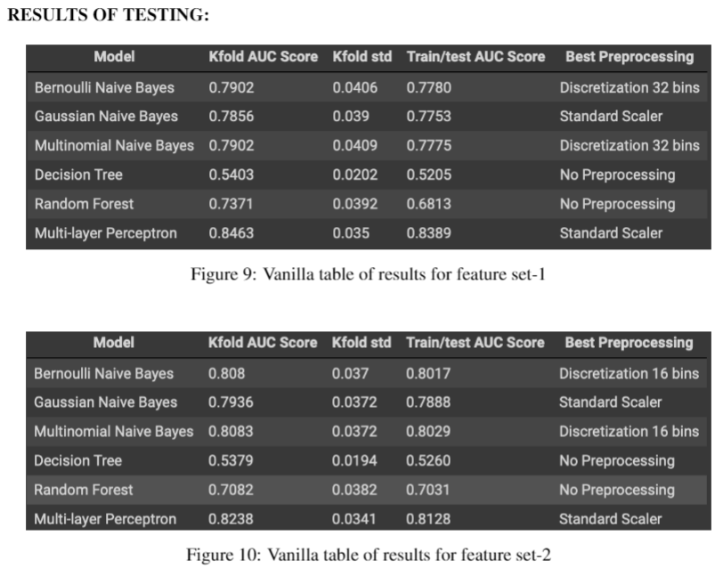
Testing of Vanilla Models
Test bench setup with scikit-learn’s k-fold cross validation
Constant random state
Scoring on ROC AUC
k = 10
Goal to determine most promising models and feature set
We tested:
Gaussian Naïve Bayes
Bernoulli Naïve Bayes
Multinomial Naïve Bayes
Decision Tree
Random Forest
Multi-layer Perceptron

Slide 9

Model Selection

Slide 10
Model Selection / Optimization
The testing of vanilla models showed that the following models were the most promising:
Multinomial Naïve Bayes
Random Forest
Multi-layer Perceptron
These models were selected for optimization using scikit-learn’s modelseceltion library and more specifically GridSearchCV
Notes:
From the testing we saw that Multinomial Naïve Bayes, Random Forest and Multi-layer Perceptron had the highest AUC score. These three models were select for further investigation through hyperparameter optimization.

Slide 11
Results of the Hyper-parameter Optimization
Performance of Multinomial Naïve Bayes increased slightly.
Performance of Random Forest increased significantly
Performance of Multi-layer Perceptron increased slightly
Conclusions: Random Forest and Multi-layer Perceptron look promising!
Model | Average AUC score | STD AUC score
Multinomial Naïve Bayes | 0.7877 | 0.0379
Multinomial Naïve Bayes Tuned | 0.7902 | 0.0409
Random Forest | 0.7371 | 0.0392
Random Forest Tuned | 0.855 | 0.0339
Multi-layer Perceptron | 0.8463 | 0.035
Multi-layer Perceptron Tuned | 0.8536 | 0.0365
Notes:
The hyperparameter optimization showed that Random Forest and Multi-layer Percetron were the two strongest models.

Slide 12
Combining Multiple Models
The last thing we did was testing the combination of optimized Random Forest and Multi-layer Perceptron
Slight increase in AUC score through combination of both classifiers
→ Final model!
Model | Average AUC score | STD AUC score
Random Forest Tuned | 0.855 | 0.0339
Multi-layer Perceptron Tuned | 0.8536 | 0.0365
Combined RF + MLP | 0.8573 | 0.0338
Notes:
Next, we tested the combination of the optimized Random Forest and Multi-layer Perceptron using scikit-learns ensemble library and more specifically VotingClassifier. This combination increased the average AUC score slightly and therefore we chose this model as our final model.

Slide 13
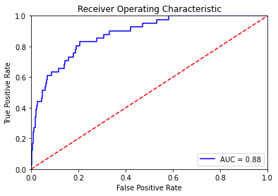
Estimating AUC score on unseen (unlabeled) data
Final step: AUC score estimate on unseen data (10% of initial dataset )
→ estimated AUC score of 0.88
Notes:
The final step was to calculate the estimated AUC score on the unseen labeled data that we removed from the initial dataset. The estimated AUC score was 0.88.

Slide 14

Thanks For Listening – Any Questions?

